Slide 1
Style and Vignette
House on Mango Street

Slide 2
What is style?
the manner of expression of a particular writer produced by: choice of words, sentence structures, use of literary devices, rhythm, and other elements of composition

Slide 3
Many writers have their own particular style.
i.e. - scientific, expository, poetic, and journalistic

Slide 4
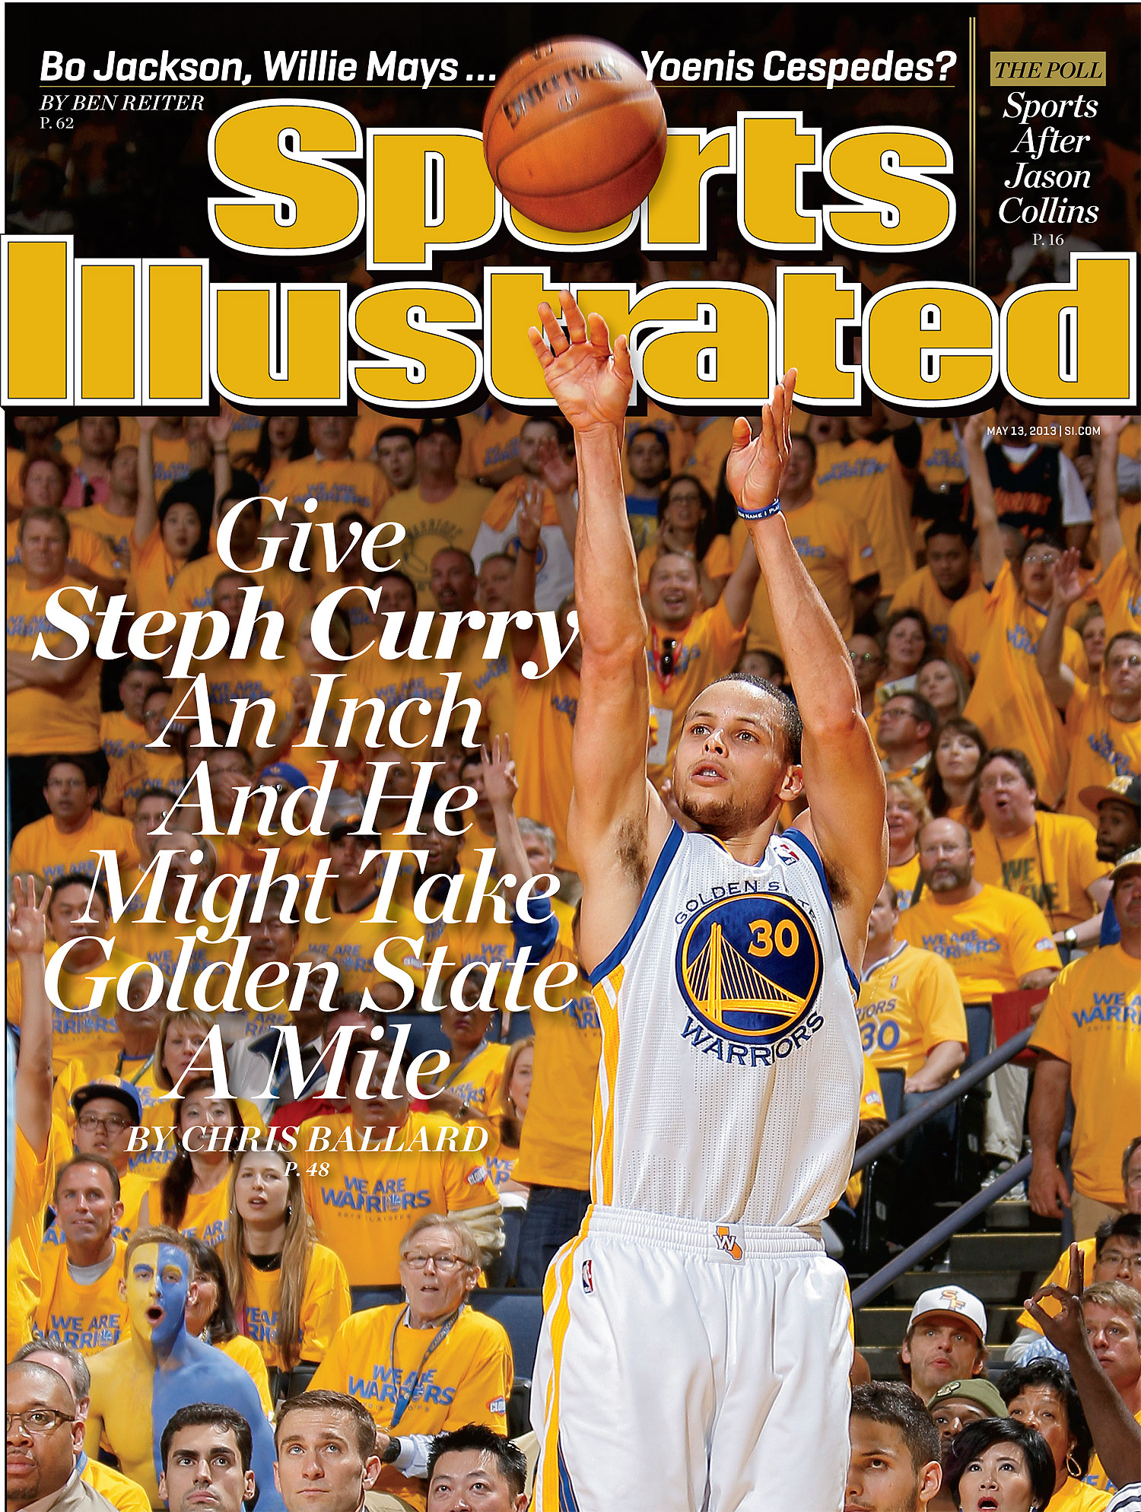
An article from a magazine or a newspaper is written in a different style than one from a scientific journal.

Slide 5
Newspaper: journalistic, factual but may be persuasive or biased, should appeal to wide variety of readers
Scientific Journal: scientific, uses science-related words, should be solely factual, may only appeal to readers who share same scientific knowledge

Slide 6
What is vignette?
A short, well-written sketch or descriptive scene

Slide 7
It does not have a plot, which would make it a story, but it does reveal something about the elements in it

Slide 8
It may reveal character, or mood, or tone

Slide 9
It may have a theme or idea of its own that it wants to convey

Slide 10
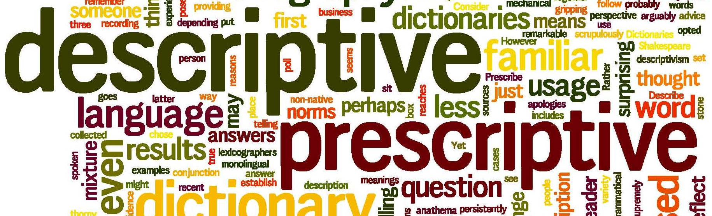
It is the description of the scene or character that is important

Slide 11
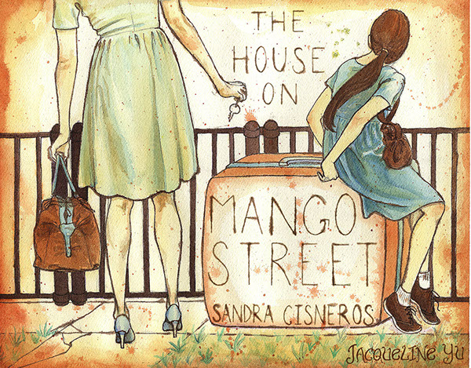
Sandra Cisneros’ novel The House on Mango Street is written in a series of vignettes

