Slide 1
Tuesday January 16th, 2017
House on Mango Street Day 1

Slide 2
Agenda
Routine Overview (5 min)
Vocabulary Work (15 min)
House on Mango Street Background (5 min)
Research Project Overview (5 min)
Research (15 min)
Create Poster (15 min)
Determine how to present (15 min)

Slide 3
Typical Routine
Vocabulary Work
Reading of some sort
Writing/Reflection on Readin

Slide 4
What are we doing and Why are we doing this?
Objectives
To work on our research skills
Understand how an authors life can influence their work
Student Learner Outcome (SLO)
Communicate Effectively
Problem Solving

Slide 5
Vocabulary Work
Go to OneNote
Go to “Content Library”
Go to “Vocabulary” tab
Open 01-17-18 HOMS Week 1
Copy the words and definitions onto a sheet of binder paper that you will turn in Friday.

Slide 6
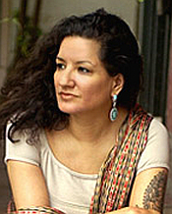
House on Mango Street
Written by Sandra Cisneros
Based on Cisneros life
About a young Chicana girls growing up in a poor Latino area of Chicago. The book deals with the power of language, self-definition, and cultural assimilation.

Slide 7
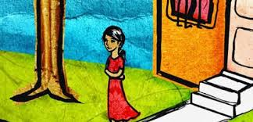
House on Mango Street Review
Told in a series of vignettes stunning for their eloquence, The House on Mango Street is Sandra Cisneros’ greatly admired novel of a young girl growing up in the Latino section of Chicago … It has entered the canon of coming-of-age classics. Sometimes heartbreaking, sometimes deeply joyous, The House on Mango Street tells the story of Esperanza Cordero, whose neighborhood is one of harsh realities and harsh beauty. Esperanza doesn’t want to belong—not to her rundown neighborhood, and not to the low expectations the world has for her. Esperanza’s story is that of a young girl coming into her power, and inventing for herself what she will become

Slide 8
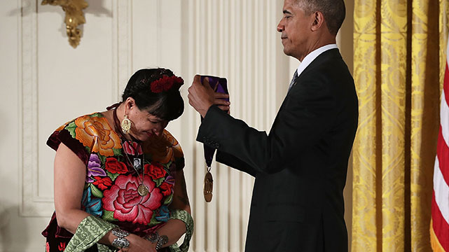
Sandra Cisneros Research
Best way to understand an Authors work is to understand an author!
Your group will research some aspect of Cisneros’ life, create a poster about that aspect and present it tomorrow.
I will assign topics. Refer to your hand out to understand the information you need to gather.

Slide 9
Research Groups Assignments
Group 1: Biography - Where and when was Cisneros born? Who are her parents and/or siblings? Where did she grow up? Go to school? Etc.
Group 2: Writing Career - When did Cisneros start writing? Did she have formal training, and if so, where? What else has Cisneros written? What other genres of writing is she known for? Etc.
Group 3: Influences - Who has influenced Cisneros? Why did she start writing? Does her culture influence her writing? Are there recurring themes or ideas in her work? Etc.
Group 4: Reviews and Critiques - What do others say about Cisneros’ work? Are there positive reviews/negative critiques? What do others say about her style of writing? Etc.
Group 5: Other Jobs and Interests - What else has Cisneros done? Where has she worked? What are her interests/passions? Etc.

Slide 10
Research

Slide 11
Poster

Slide 12
Presentation

